Slide 1
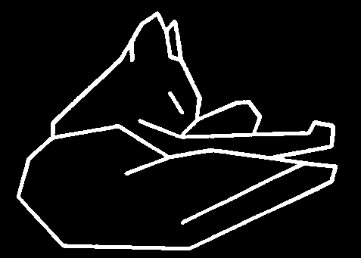
Introduction
Computer Vision
Part I
Feature Extraction (1)
Image Enhancement
Zhigang Zhu, City College of New York zhu@cs.ccny.cuny.edu
Notes:
This course is a basic introduction to parts of the field of computer vision. This version of the course covers topics in 'early' or 'low' level vision and parts of 'intermediate' level vision. It assumes no background in computer vision, a minimal background in Artificial Intelligence and only basic concepts in calculus, linear algebra, and probability theory.

Slide 2
Introduction
Computer Vision
Part I
Feature Extraction (1)
Image Enhancement
Zhigang Zhu, City College of New York zhu@cs.ccny.cuny.edu
Notes:
This course is a basic introduction to parts of the field of computer vision. This version of the course covers topics in 'early' or 'low' level vision and parts of 'intermediate' level vision. It assumes no background in computer vision, a minimal background in Artificial Intelligence and only basic concepts in calculus, linear algebra, and probability theory.

Slide 3
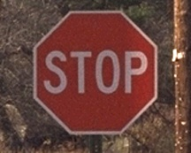
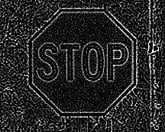


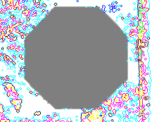

What are Image Features?
Local, meaningful, detectable parts of the image.
Notes:
Clockwise: color image, gradients, color segmentation, boundaries, integration of color and boundary, stop sign

Slide 4
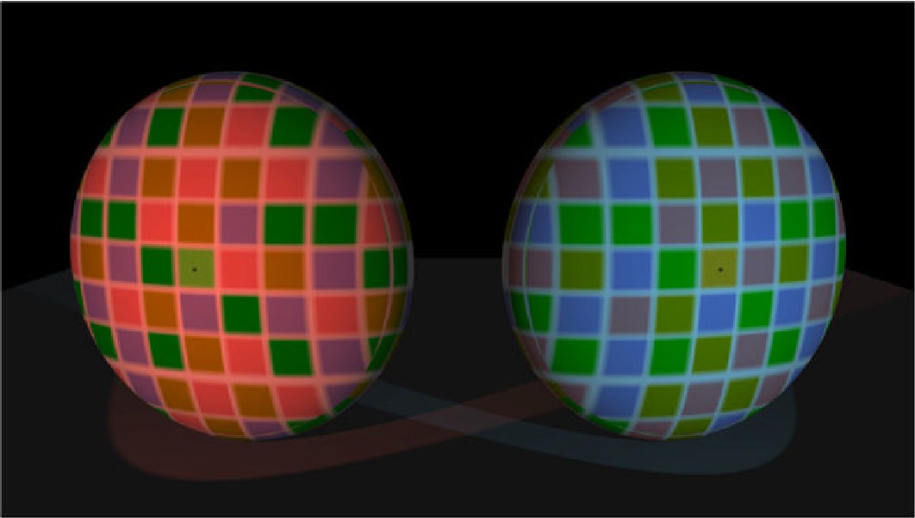
More Color Woes
Squares with dots in them are the same color

Slide 5
Topics
Image Enhancement
Brightness mapping
Contrast stretching/enhancement
Histogram modification
Noise Reduction
……...
Mathematical Techniques
Convolution
Gaussian Filtering
Edge and Line Detection and Extraction – next lecture
Region Segmentation
Contour Extraction
Corner Detection

Slide 6
Image Enhancement
Goal: improve the ‘visual quality’ of the image
for human viewing
for subsequent processing
Two typical methods
spatial domain techniques....
operate directly on image pixels
frequency domain techniques....
operate on the Fourier transform of the image
No general theory of ‘visual quality’
General assumption: if it looks better, it is better
Often not a good assumption

Slide 7
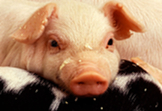

Spatial Domain Methods
T(I(x,y))
neighborhood N
I(x,y)
I’(x,y)
Transformation T
point - pixel to pixel
area - local area to pixel
global - entire image to pixel
Neighborhoods
typically rectangular
typically an odd size: 3x3, 5x5, etc
centered on pixel I(x,y)
Many IP algorithms rely on this basic notion
I’(x,y) = T(I(x,y))
O=T(I)

Slide 8
Point Transforms: General Idea
O = T(I)
Transfer
Function T
Input pixel value, I, mapped to output pixel value, O, via transfer function T.
255
OUTPUT
0
255
INPUT
Notes:
Usually a monotonic function, 1-1 mapping

Slide 9
Grayscale Transforms
Photoshop ‘adjust curve’ command
Output gray value I’(x,y)
Input gray value I(x,y)

Slide 10
Point Transforms: Brightness

Slide 11
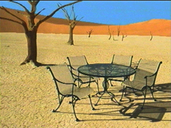
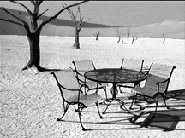
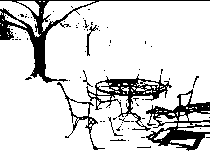
Point Transforms:Thresholding
T is a point-to-point transformation
only information at I(x,y) used to generate I’(x,y)
Thresholding
255
I’(x,y) =
I_{max} if I(x,y) > t
I_{min} if I(x,y) ≤ t
0
0
t
255
t=89

Slide 12
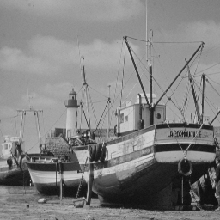
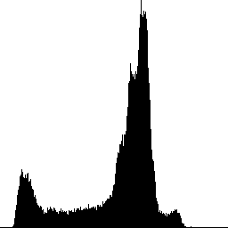
Point Transforms: Linear Stretch
255
OUTPUT
0
INPUT
255

Slide 13
Linear Scaling
Consider the case where the original image only utilizes a small subset of the full range of gray values:
New image uses full range of gray values.
What's F? {just the equation of the straight line}

Slide 14
Linear Scaling
F is the equation of the straight line going through the point (I_{min} , 0) and (I_{max} , K)
useful when the image gray values do not fill the available range.
Implement via lookup tables
Notes:
Slope is m and the I’-intercept is b

Slide 15
Scaling Discrete Images
Have assumed a continuous grayscale.
What happens in the case of a discrete grayscale with K levels?

Slide 16
Non-Linear Scaling: Power Law
γ
O = I
γ < 1 to enhance contrast in dark regions
γ > 1 to enhance contrast in bright regions.
1
γ<1
0
.
5
γ=1
γ>1
0
0
0
.
5
1

Slide 17
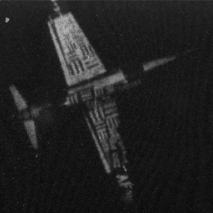
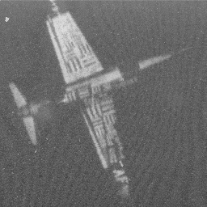
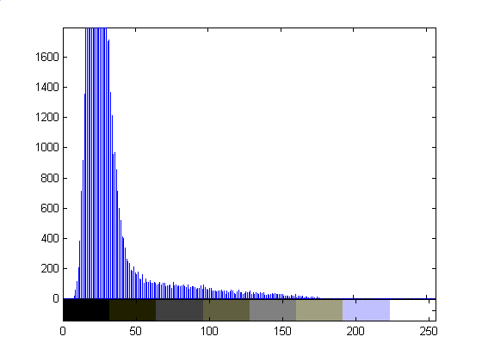
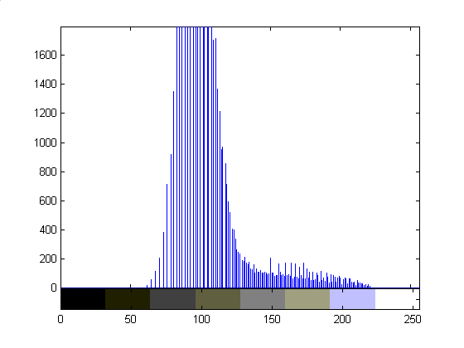
Square Root Transfer: γ=.5

Slide 18
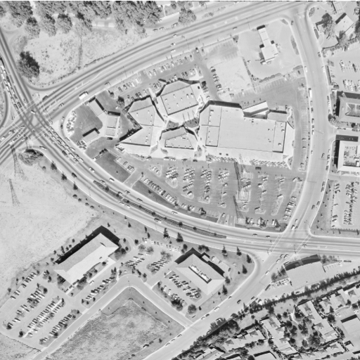
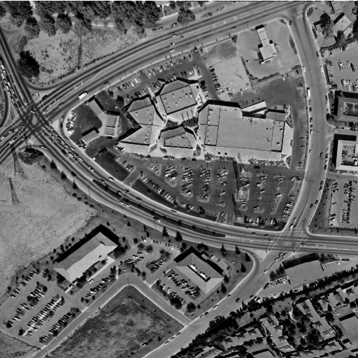
γ=3.0

Slide 19
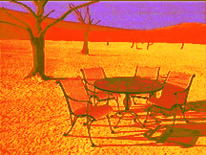
Examples
Technique can be applied to color images
same curve to all color bands
different curves to separate color bands:

Slide 20
Point Transforms:Thresholding
T is a point-to-point transformation
only information at I(x,y) used to generate I’(x,y)
Thresholding
255
I’(x,y) =
I_{max} if I(x,y) > t
I_{min} if I(x,y) ≤ t
0
0
t
255
t=89

Slide 21
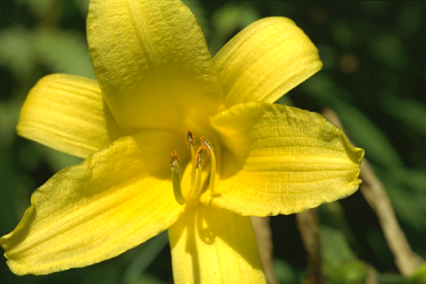
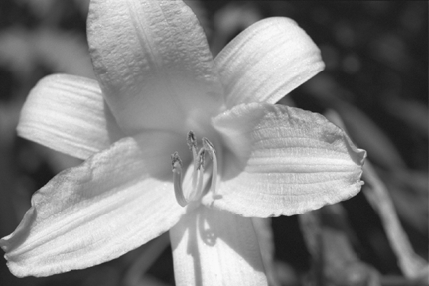

Threshold Selection
Arbitrary selection
select visually
Use image histogram
Threshold

Slide 22
Histograms
The image shows the spatial distribution of gray values.
The image histogram discards the spatial information and shows the relative frequency of occurrence of the gray values.

Slide 23
Image Histogram
The histogram typically plots the absolute pixel count as a function of gray value:
For an image with dimensions M by N

Slide 24
Probability Interpretation
The graph of relative frequency of occurrence as a function of gray value is also called a histogram:
Interpreting the relative frequency histogram as a probability distribution, then:
Σ
P(I(x,y) = i) = H(i)/(MxN)
Σ

Slide 25
Cumulative Density Function
Interpreting the relative frequency histogram as a probability distribution, then:
Curve is called the cumulative distribution function
P(I(x,y) = i) = H(i)/(MxN)
Gray Value

Slide 26
Examples

Slide 27
Color Histograms

Slide 28
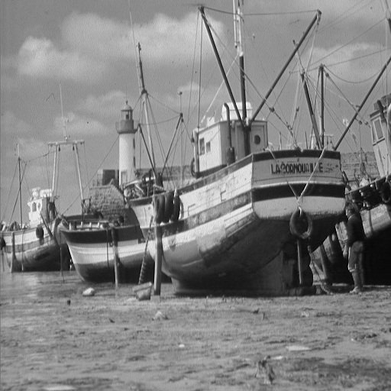
Histogram Equalization
Image histograms consist of peaks, valleys, and low plains
Peaks = many pixels concentrated in a few grey levels
Plains = small number of pixels distributed over a wider range of grey levels

Slide 29
Histogram Equalization
The goal is to modify the gray levels of an image so that the histogram of the modified image is flat.
Expand pixels in peaks over a wider range of gray-levels.
“Squeeze” low plains pixels into a narrower range of gray levels.
Utilizes all gray values equally
Example Histogram:
Note low utilization of small gray values

Slide 30
Desired Histogram
All gray levels are used equally.
Has a tendency to enhance contrast.

Slide 31
Brute Force
How are the gray levels in the original image changed to produce the enhanced image?
Method 1. Choose points randomly.
Method 2. Choice depends on the gray
levels of their neighboring points.
Computationally expensive.
Approximations.

Slide 32
Histogram Equalization
Mapping from one set of grey-levels, Ι, to a new set, Ο.
Ideally, the number of pixels, N_{p}, occupying each grey level should be:
To approximate this, apply the transform
Where CH is the cumulative histogram (see next slide)
j is the gray value in the source image
i is the gray value in the equalized image
M*N
N_{p} =
G
CH(j)
i = MAX
0, round
-1
N_{p}

Slide 33
Example
j
H(j)
CH(j)
i
0
100
100
900
1600
2100
2200
2300
2400
2400
0
G=8
MxN=2400
N_{p}=300
1
800
2
j
2
700
4
CH(j) = Σ H(i)
3
500
6
i=0
4
100
6
5
100
7
6
100
7
7
0
7
800
600
400
200
0
800
600
400
200
0
ideal
0 1 2 3 4 5 6 8
0 1 2 3 4 5 6 8

Slide 34
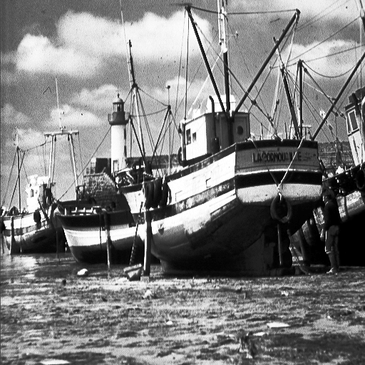
Example

Slide 35
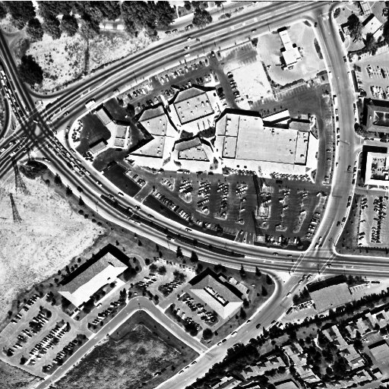
Comparison
Original
γ>1
Histogram
equalization

Slide 36
Why?
Given MxN input image I with gray scale p₀….p_{k} and histogram H(p).
Desire output image O with gray scale q₀….q_{k} and uniform histogram G(q)
Treat the histograms as a discrete probability density function. Then monotonic transfer function m = T(n) implies:
The sums can be interpreted as discrete distribution functions.
m
n
Σ G(q_{i}) = Σ H(p_{j})
i=0
j=0
From Image Processing, Analysis, and Machine Vision, Sonka et al.

Slide 37
Why? continued
MxN
The histogram entries in G must be:
(because G is uniform)
Plug this into previous equation to get:
Now translate into continuous domain (can’t really get uniform distributions in the discrete domain)
G(i) =
q_{k} - q₀
m
MxN
n
Σ = Σ H(p_{i})
q_{k} - q₀
i=0
i=0
q_{m}
MxN
p_{n}
ds
= H(s)ds
q_{k} - q₀
q₀
p₀
MN(q_{m}-q₀)
q_{k} - q₀

Slide 38
Why? continued
Solve last equation for q to get:
Map back into discrete domain to get:
Leads to an algorithm…..
q_{k} - q₀
p_{n}
q_{m} = T(p) =
H(s)ds + q₀
MN
p₀
q_{k} - q₀
p_{n}
q_{m} = T(p) =
Σ H(i) + q₀
MN
i=p₀

Slide 39
Histogram Equalization Algorithm
For an NxM image of G gray levels, say 0-255
Create image histogram
For cumulative image histogram H_{c}
Set
Rescan input image and write new output image by setting
G-1
T(p) = round ( H_{c} (p))
NM
g_{q} = T(g_{p})

Slide 40
Observations
Acquisition process degrades image
Brightness and contrast enhancement implemented by pixel operations
No one algorithm universally useful
γ > 1 enhances contrast in bright images
γ < 1 enhances contrast in dark images
Transfer function for histogram equalisation proportional to cumulative histogram

Slide 41
Noise Reduction
What is noise?
How is noise reduction performed?
Noise reduction from first principles
Neighbourhood operators
linear filters (low pass, high pass)
non-linear filters (median)
+
=
image
noise
‘grainy’ image

Slide 42
Noise
Image
Plot of image brightness.
Noise is additive.
Noise fluctuations are rapid
high frequency.
Noise
Image + Noise

Slide 43
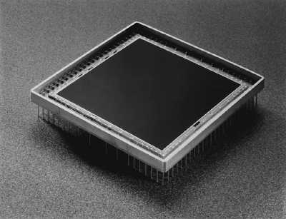
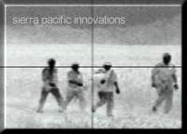
Sources of Noise
Sources of noise = CCD chip.
Electronic signal fluctuations in detector.
Caused by thermal energy.
Worse for infra-red sensors.
Electronics
Transmission
Radiation from the long wavelength IR band is used in most infrared imaging applications

Slide 44
Noise Model
Plot noise histogram
Typical noise distribution is normal or Gaussian
Mean(noise) μ = 0
Standard deviation σ
2σ
1
1
2
(x-μ)
η(x) = exp -
2πσ²
2
σ
μ

Slide 45
Effect of σ
Integral under curve is 1
σ=10
σ=20
σ=30

Slide 46
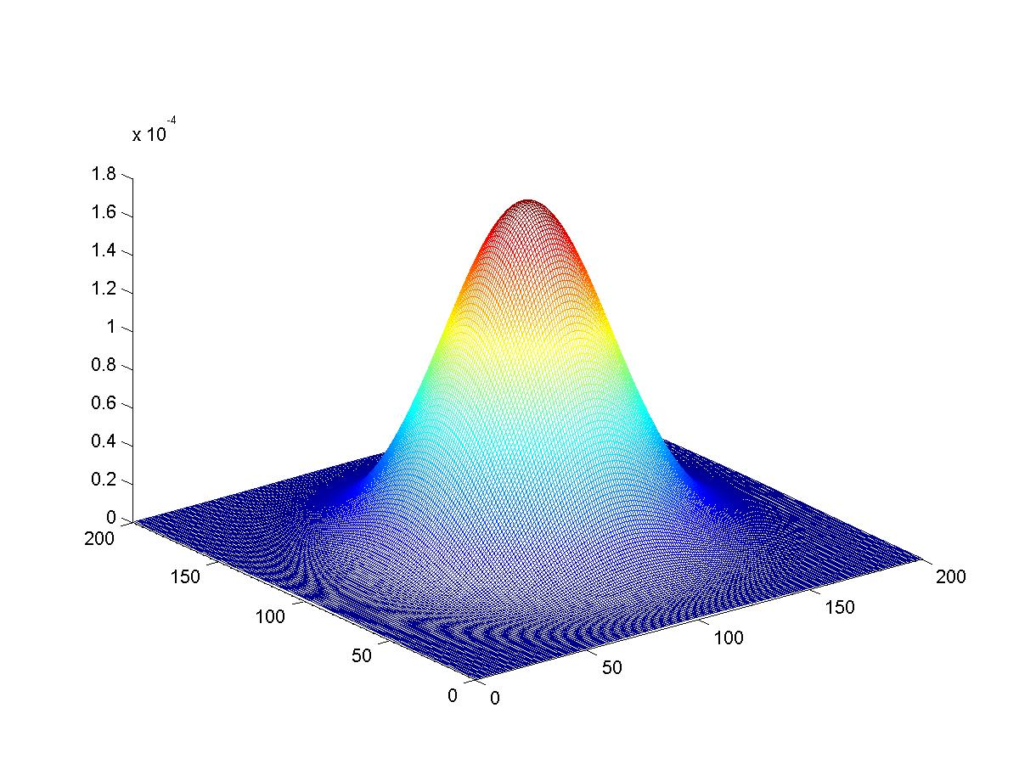
Two Dimensional Gaussian

Slide 47
Noise
Noise varies above and below uncorrupted image.
Image
Image
+
Noise

Slide 48
Noise Reduction - 1
How do we reduce noise?
Consider a uniform 1-d image and add noise.
Focus on a pixel neighbourhood.
Averaging the three values should result in a value closer to original uncorrupted data
Especially if gaussian mean is zero
A_{i-1} A_{i} A_{i+1}
C_{i}

Slide 49
Noise Reduction - 1
Averaging ‘smoothes’ the noise fluctuations.
Consider the next pixel A_{i+1}
Repeat for remainder of pixels.
A_{i-1} A_{i} A_{i+1} A_{i+2}
C_{i+1}

Slide 50
Neighborhood Operations
All pixels can be averaged by convolving 1-d image A with mask B to give enhanced image C.
Weights of B must equal one when added together.
Why?
C = A * B
B = [ B1 B2 B3 ]
C_{i} = A_{i-1} ×B₁ + A_{i} ×B₂ + A_{i+1} ×B₃
B = [1 1 1]
C_{i} =
1
3
A_{i-1} + A_{i} + A_{i+1}
3

Slide 51


2D Analog of 1D Convolution
Consider the problem of blurring a 2D image
Here’s the image and a blurred version:
How would we do this?
What’s the 2D analog of 1D convolution?

Slide 52
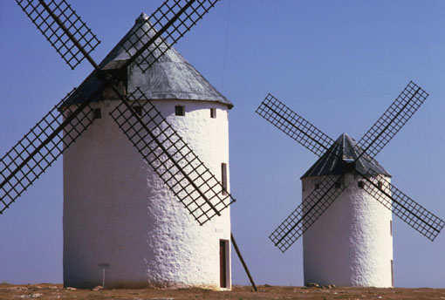

2D Blurring Kernel
C = A * B
B becomes
1 1 1
1 1 1
1 1 1
1
B =
9

Slide 53
Convolution: the key element in CNNs
Extremely important concept in computer vision, image processing, signal processing, etc.
Lots of related mathematics (we won’t do)
General idea: reduce a filtering operation to the repeated application of a mask (or filter kernel) to the image
Kernel can be thought of as an NxN image
N is usually odd so kernel has a central pixel
In practice
(flip kernel)
Align kernel center pixel with an image pixel
Pointwise multiply each kernel pixel value with corresponding image pixel value and add results
Resulting sum is normalized by kernel weight
Result is the value of the pixel centered on the kernel

Slide 54
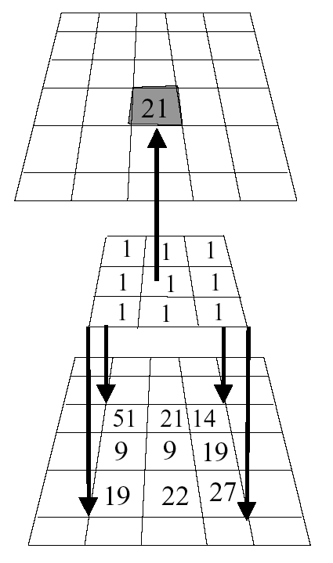
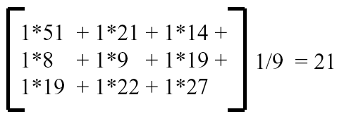
Example
Kernel is aligned with pixel in image, multiplicative sum is computed, normalized, and stored in result image.
Process is repeated across image.
What happens when kernel is near edge of input image?
Result
Image
Kernel
Image

Slide 55
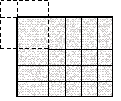
Border Problem
missing samples are zero
missing samples are gray
copying last lines
reflected indexing (mirror)
circular indexing (periodic)
truncation of the result

Slide 56
Convolution Size
Image size = M₁ × N₁
Mask size = M₂ × N₂
N₁
Convolution size =
M₁- M₂ +1 × N₁-N₂+1
N₂
N₁-N₂+1
Typical Mask sizes
= 3×3, 5 ×5, 7×7,
9 ×9, 11×11
What is the convolved
image size for a 128
× 128 image and
7 × 7 mask?

Slide 57
Convolution
= I M
*

Slide 58
Properties of Convolution
Commutative: f₁(t) * f₂ (t) = f₂ (t) * f₁ (t)
Distributive: f₁(t) * [f₂(t) + f₃ (t)] = f₁(t) * f₂ (t) + f₁ (t) * f₃ (t)
Associative: f₁(t) * [f₂(t) * f₃ (t)] = [f₁(t) * f₂(t)] * f₃ (t)
Shift: if f₁(t) * f₂(t) = c(t), then
f₁(t) * f₂(t-T) = f₁(t-T) * f₂(t) = c(t-T)
Convolution with impulse: f(t) *δ(t) = f(t)
Convolution with shifted impulse: f(t) *δ(t-T) = f(t-T)

Slide 59
Noise Reduction - 1
Image + Noise
Image + Noise - Blurred
Uncorrupted Image

Slide 60
Noise Reduction - 1
Technique relies on high frequency noise fluctuations being ‘blocked’ by filter. Hence, low-pass filter.
Fine detail in image may also be smoothed.
Balance between keeping image fine detail and reducing noise.

Slide 61
Noise Reduction - 1
Saturn image coarse detail
Boat image contains fine detail
Noise reduced but fine detail also smoothed

Slide 62


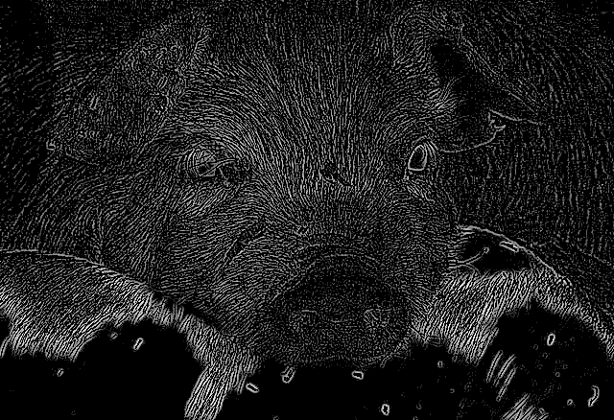
hmmmmm…..
Image
Blurred Image
-
=

Slide 63
Noise Reduction - 2: Median Filter
Nonlinear Filter
Compute median of points in neighborhood
Has a tendency to blur detail less than averaging
Works very well for ‘shot’ or ‘salt and pepper’ noise
Original
Low-pass
Median
Notes:
How does media filter work?
Get data from a window centered at the to-be-processed pixel
Sort the data (from min to max)
Put the median value in the filtered image

Slide 64
Noise Reduction - 2
Low-pass
Median
Low-pass: fine detail smoothed by averaging
Median: fine detail passed by filter

Slide 65
Edge Preserving Smoothing
Smooth (average, blur) an image without disturbing
Sharpness or
position
Of the edges
Nagoa-Maysuyama Filter
Kuwahara Filter
Anisotropic Diffusion Filtering (Perona & Malik, .....)
Spatially variant smoothing

Slide 66
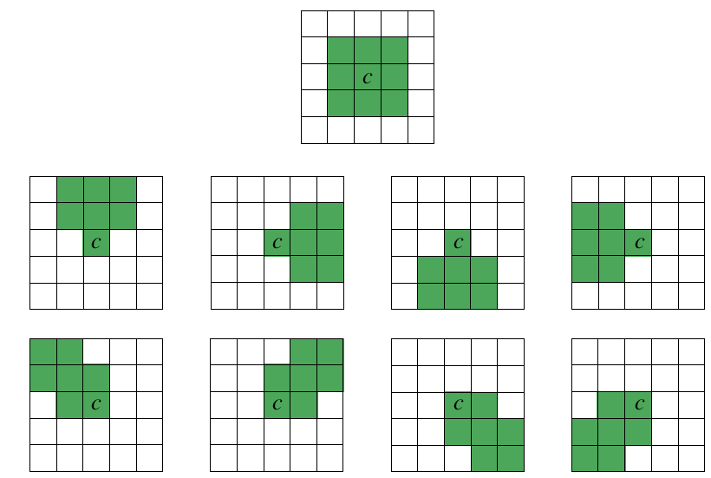
Nagao-Matsuyama Filter
Calculate the variance within nine subwindows of a 5x5 moving window
Output value is the mean of the subwindow with the lowest variance
Nine subwindows used:

Slide 67
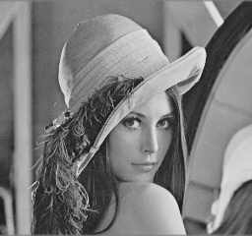
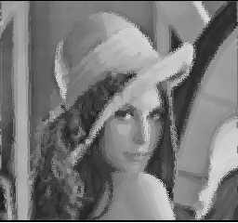
Kuwahara Filter
Principle:
divide filter mask into four regions (a, b, c, d).
In each compute the mean brightness and the variance
The output value of the center pixel (abcd) in the window is the mean value of that region that has the smallest variance.

Slide 68
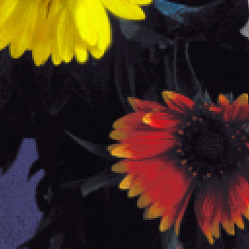

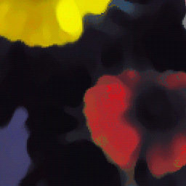

Kuwahara Filter Example
Original
Median
(1 iteration)
Median
(10 iterations)
Kuwahara

Slide 69
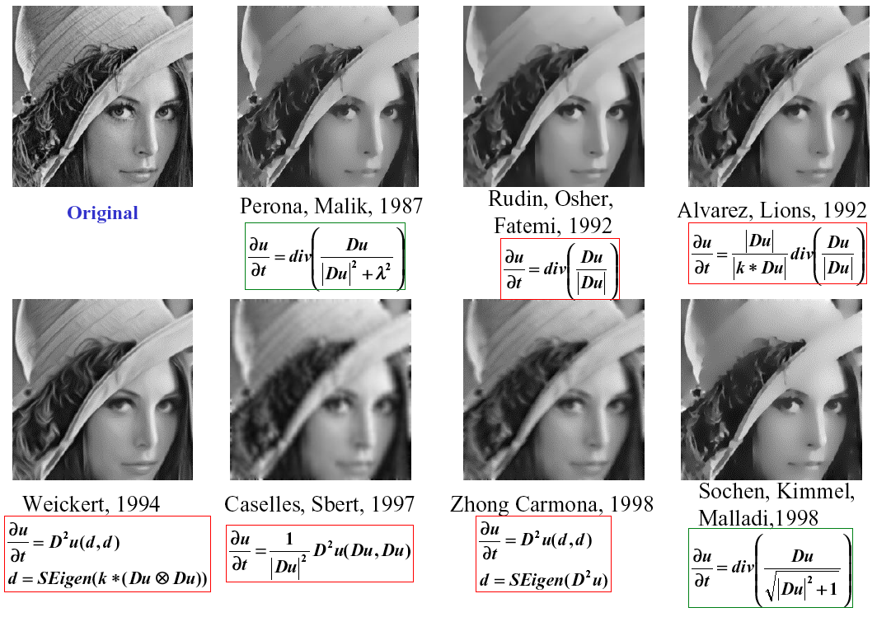
Anisotropic Diffusion Filtering
Note: Original Perona-Malik diffusion process is NOT anisotropic, although they erroneously said it was.

Slide 70
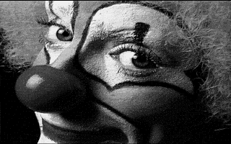

Example: Perona-Malik
In general:
Anisotropic diffusion estimates an image from a noisy image
Useful for restoration, etc.
Only shown smoothing examples
Read the literature

Slide 71
Observations on Enhancement
Set of general techniques
Varied goals:
enhance perceptual aspects of an image for human observation
preprocessing to aid a vision system achieve its goal
Techniques tend to be simple, ad-hoc, and qualitative
Not universally applicable
results depend on image characteristics
determined by interactive experimentation
Can be embedded in larger vision system
selection must be done carefully
some techniques introduce artifacts into the image data
Developing specialized techniques for specific applications can be tedious and frustrating.
Notes:
ad hoc – not general, for the case at hand apart from other applications
Latin “for this”

Slide 72
Summary
Summary
Conclusion
What is noise?
Gaussian distribution
Noise reduction
first principles
Neighbourhood
low-pass
median
Averaging pixels corrupted by noise cancels out the noise.
Low-pass can blur image.
Median may retain fine image detail that may be smoothed by averaging.

Slide 73
Introduction
CSc I6716
Part I
Feature Extraction (1)
Image Enhancement
Zhigang Zhu, City College of New York zhu@cs.ccny.cuny.edu
Notes:
This course is a basic introduction to parts of the field of computer vision. This version of the course covers topics in 'early' or 'low' level vision and parts of 'intermediate' level vision. It assumes no background in computer vision, a minimal background in Artificial Intelligence and only basic concepts in calculus, linear algebra, and probability theory.

